Slide 1


Object-Oriented proramming project : « Boulder Dash »

Slide 2
Work group
Simon
LECLAIR
Vincent PASQUET
Matthieu COQUELIN
Matthis MOYON
Notes:
Simon

Slide 3
Summary
Introduction
Diagrams
Program
Documentation
Conclusion
Notes:
Matthieu

Slide 4
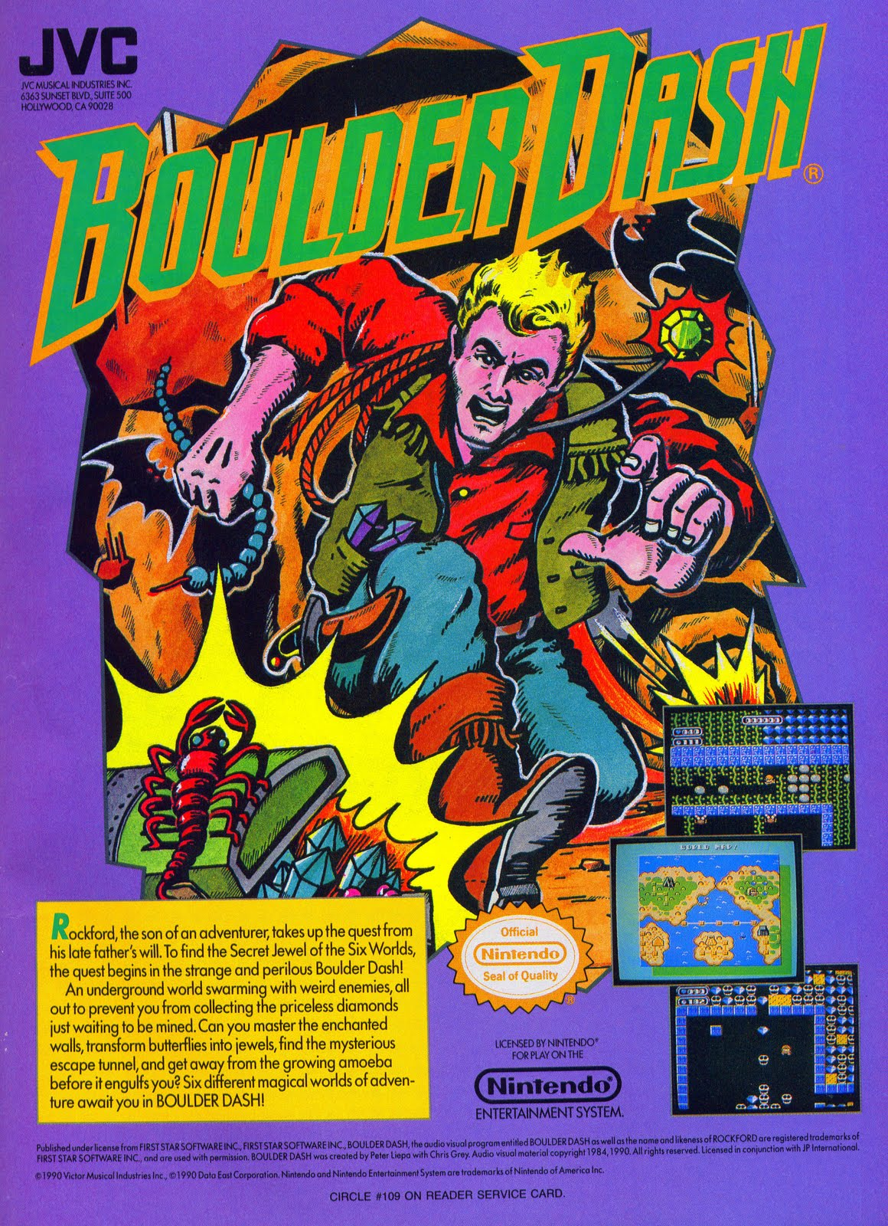
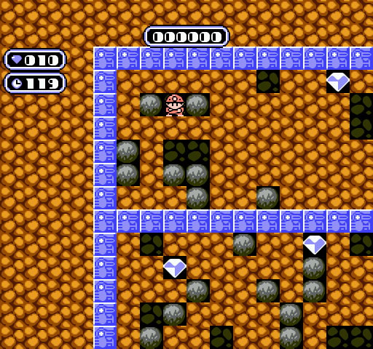
Introduction
Introduction
Notes:
Simon

Slide 5
Diagrams
Component diagram
Packages diagram
MCD
MLD
Diagrams
Notes:
Vincent

Slide 6
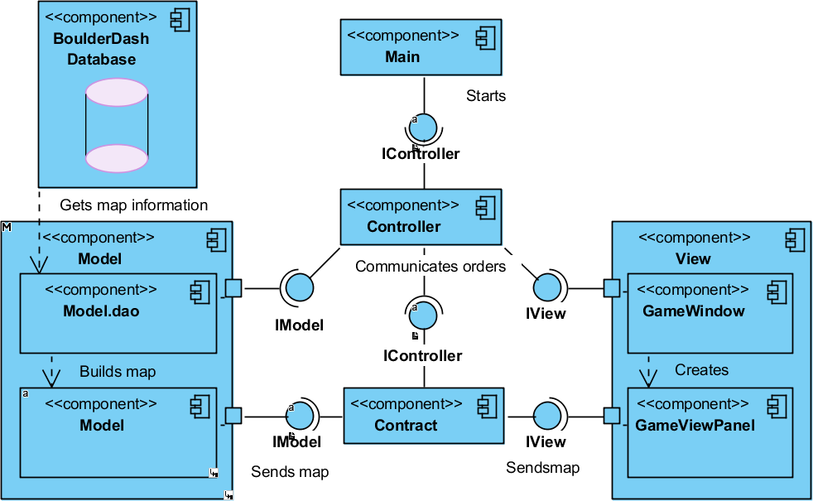
Component Diagram
Diagrams > Components diagram
Notes:
Matthis

Slide 7
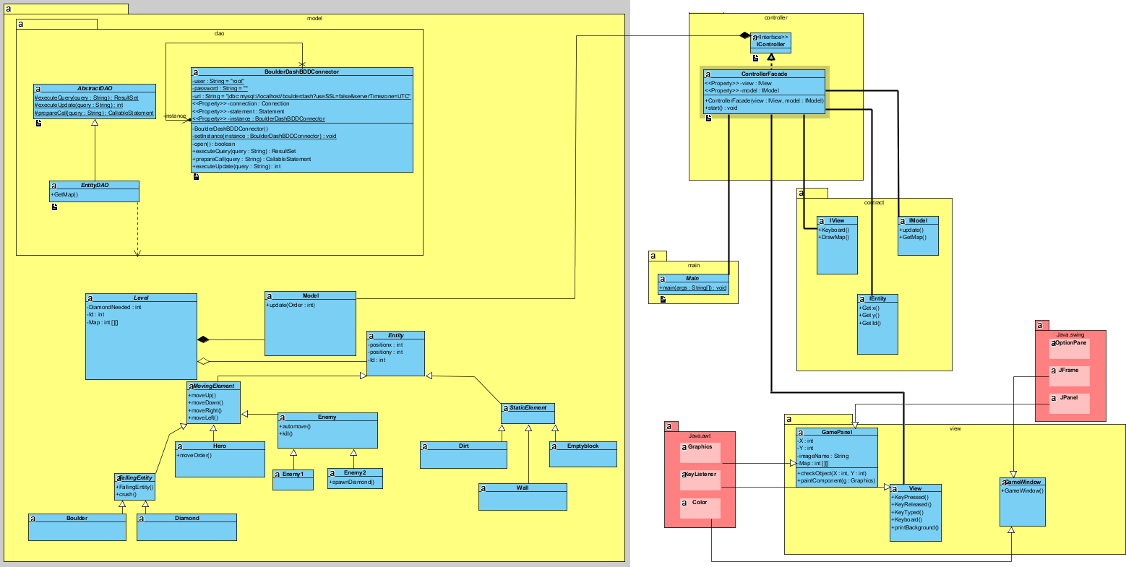
Packages Diagram
Diagrams > Packages diagram
Notes:
Simon

Slide 8


MCD & MLD
Diagrams > MCD & MLD
Notes:
Matthieu

Slide 9
Program
Database link
Map display
Program
Notes:
Vincent / Matthis

Slide 10
Documentation
Javadoc
JXR
Surefire
Documentation
Notes:
Simon / Matthieu / Matthis

Slide 11
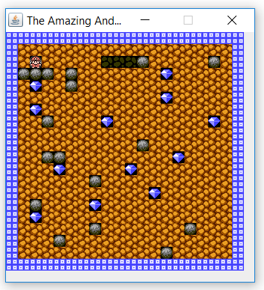
Conclusion
Conclusion
Notes:
Vincent

